Slide 1

Web-application for,
Village Vyapar
“Buy, Sell and Find just about Village Product (c2c)”

Slide 2
INDEX
No. | Content | Slide No.
1 | Group Information | 3
 | Company Profile | 4
3 | Project Definition | 5
4 | System Development Platform | 6
5 | Admin Panel | 7
6 | Customer Panel | 72
7 | Reports | 114
8 | References | 129

Slide 3
1 | Group Information | 3
 | Company Profile | 4
3 | Project Definition | 5
4 | System Development Platform | 6
5 | Admin Panel | 7
6 | Customer Panel | 72
7 | Reports | 114
8 | References | 129

Slide 4
Group Information :
GROUP NO : 04
Full Name | Enrollment No
Raja Himani Yatin | 205160694004
Chauhan Zeel Jitendrakumar | 205160694009
Parmar Devansh Rajeshbhai | 205160694023
Lashkari Parth Ashokbhai | 205160694029
Internal Faculty : :
Prof. Alka Patel

Slide 5
1
INTRODUCTION

Slide 6

Existing System :
Existing system is trading between people through calls,
and middle man therefore it is limited geographically.

Slide 7


Need for the New System :
The geographical limitation stops the business from growing and hence a lot of products do not get much attention.
It is difficult to account for the sales.
Cost of product is increased as middle man is included also
there is thin profit margin

Slide 8
Objective of New System :
This system allows to directly communicate via chat board so customer and
seller can negotiate on suitable price.
To increase the sales of the current small scale village businesses.
To provide multiple source of the same products which ensures that the
customer gets the desired quality product.
Cost of product is reduced as middle man is eliminated.
Customer can view products in any native language.

Slide 9
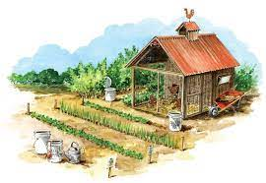
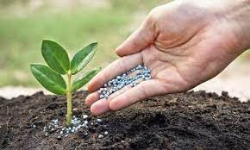
Project Definition :
This project is aimed at developing a web application that depicts online shopping of village products such as
food, Animals feed, Handicraft etc.
This web application also allows customer to
sell the product and others can purchase or vice versa
(i.e. Customer to Customer).
It provides a communication medium via chat board.

Slide 10




Core Components :
Admin
Customer
Visitor

Slide 11
Admin
Login
Manage Profile
Manage Customers
Manage Category & Sub category
Manage Products
Manage Inquiry
Manage Feedback
Generate Reports

Slide 12
Customer
Login
Manage Profile
Search Rural Product
View Categories & Sub Categories
View Rural Product in multiple language
Chat with Seller/Buyer
Inquiry
Feedback
Manage Inquiry
Manage Product
Manage Wishlist

Slide 13
Visitor
Registration
Search Rural Product
View Rural Product
View Feedback & Rating

Slide 14
Project Profile :

Slide 15
Assumptions & Constraint :

Slide 16
Advantages of Proposed System :

Slide 17
Disadvantage of Proposed System :

Slide 18
2
Requirement Determination & Analysis

Slide 19

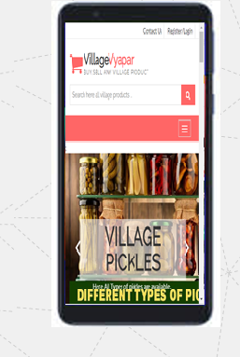
Requirement Determination

Slide 20
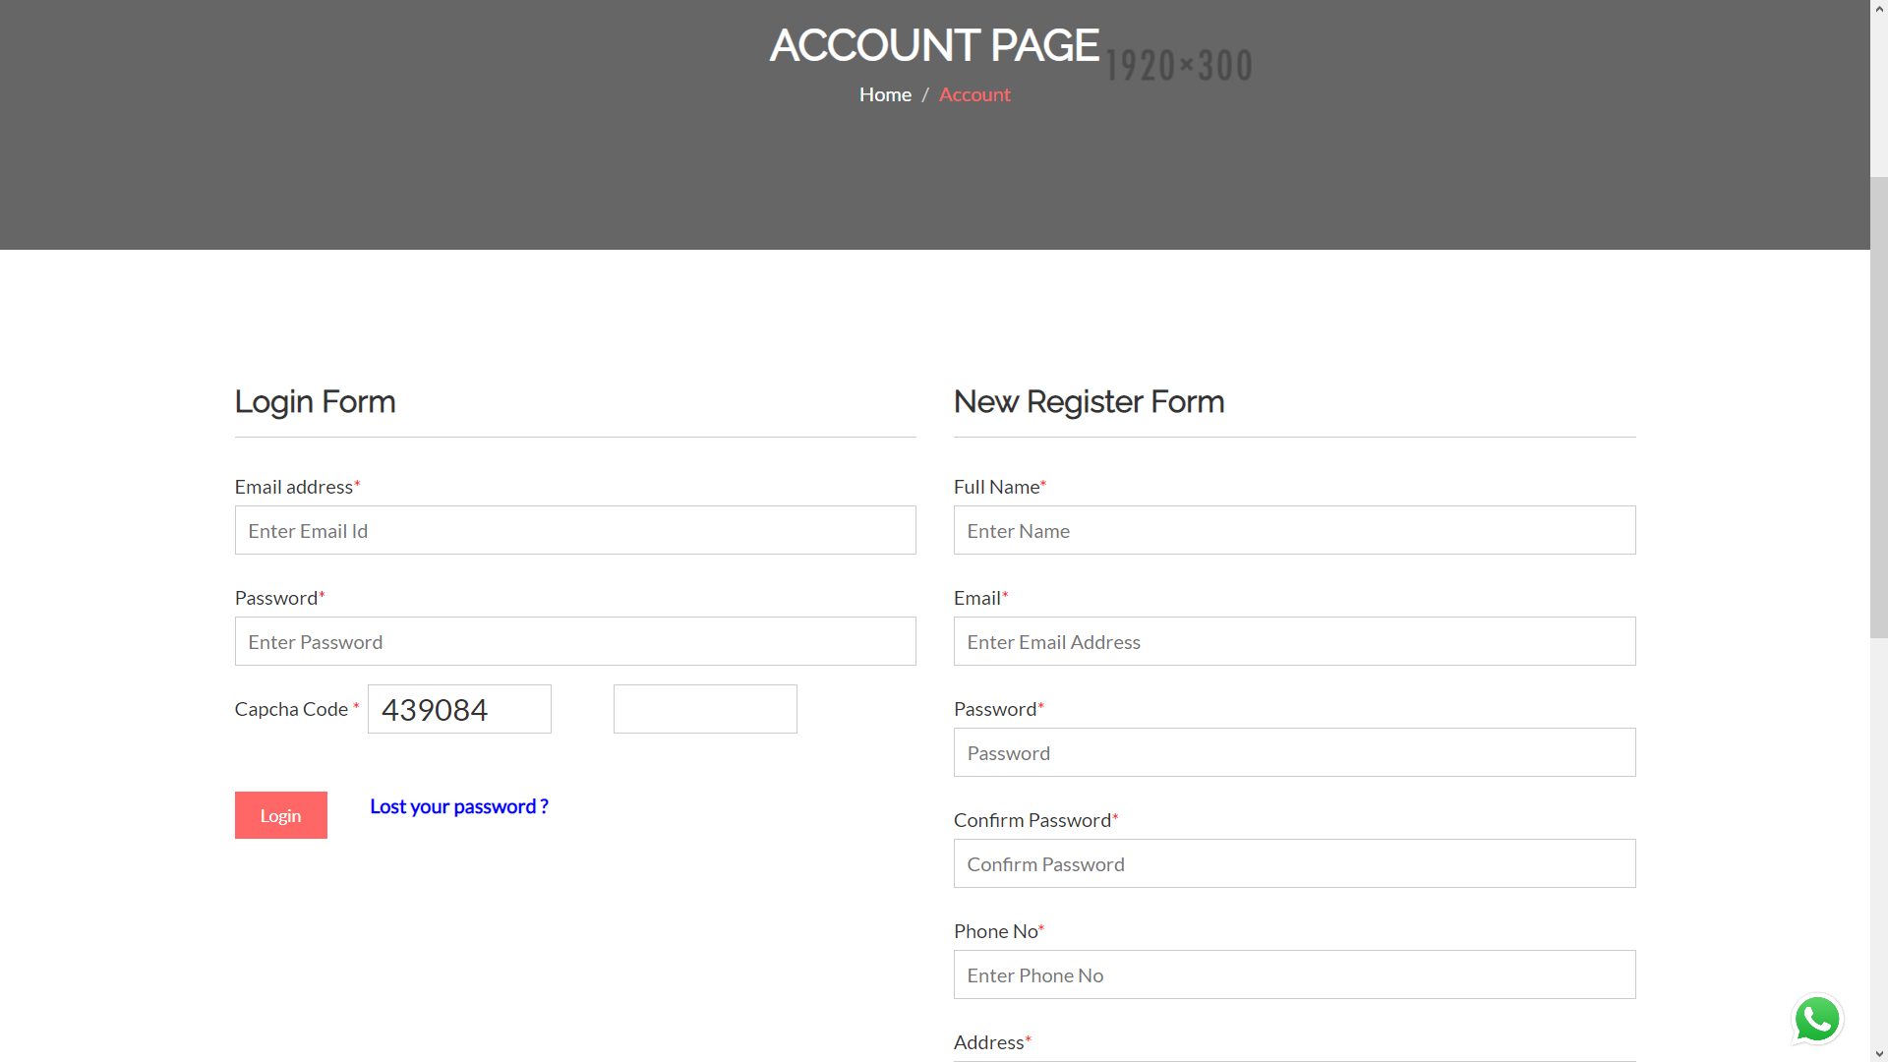
Login and Registration page

Slide 21
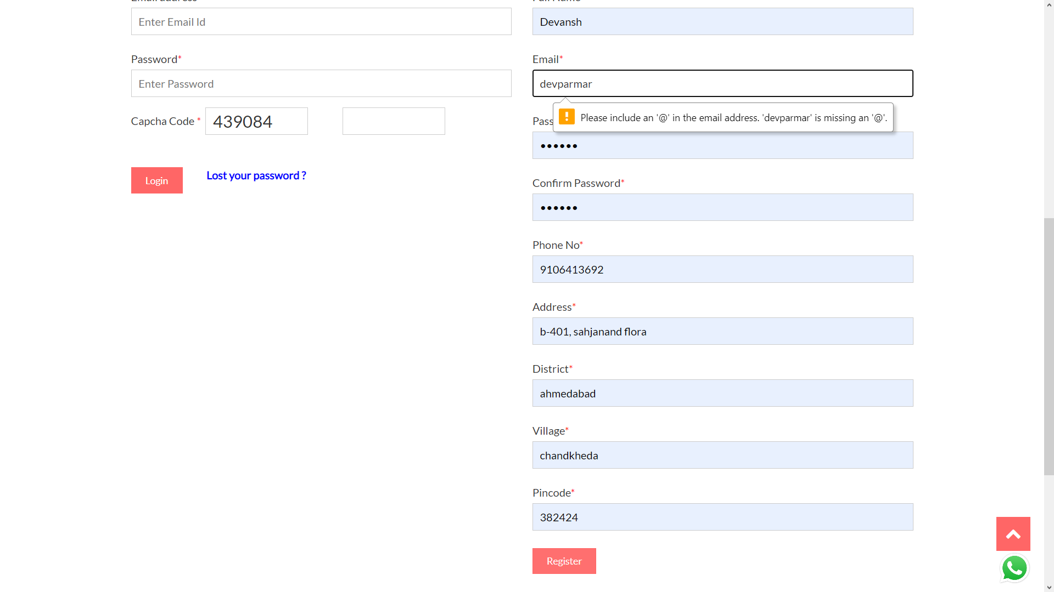
Registration with invalid credentials

Slide 22
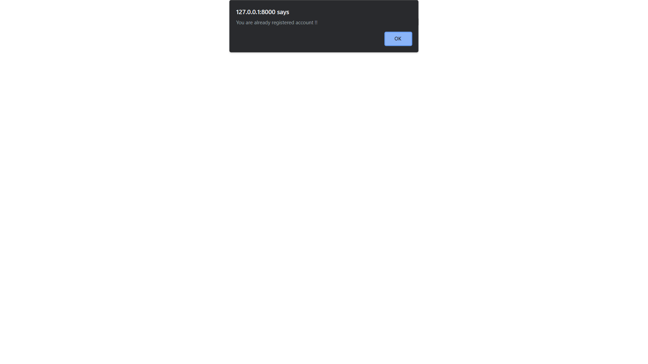
Registration with existing email

Slide 23

OTP sent at email on New Registration

Slide 24
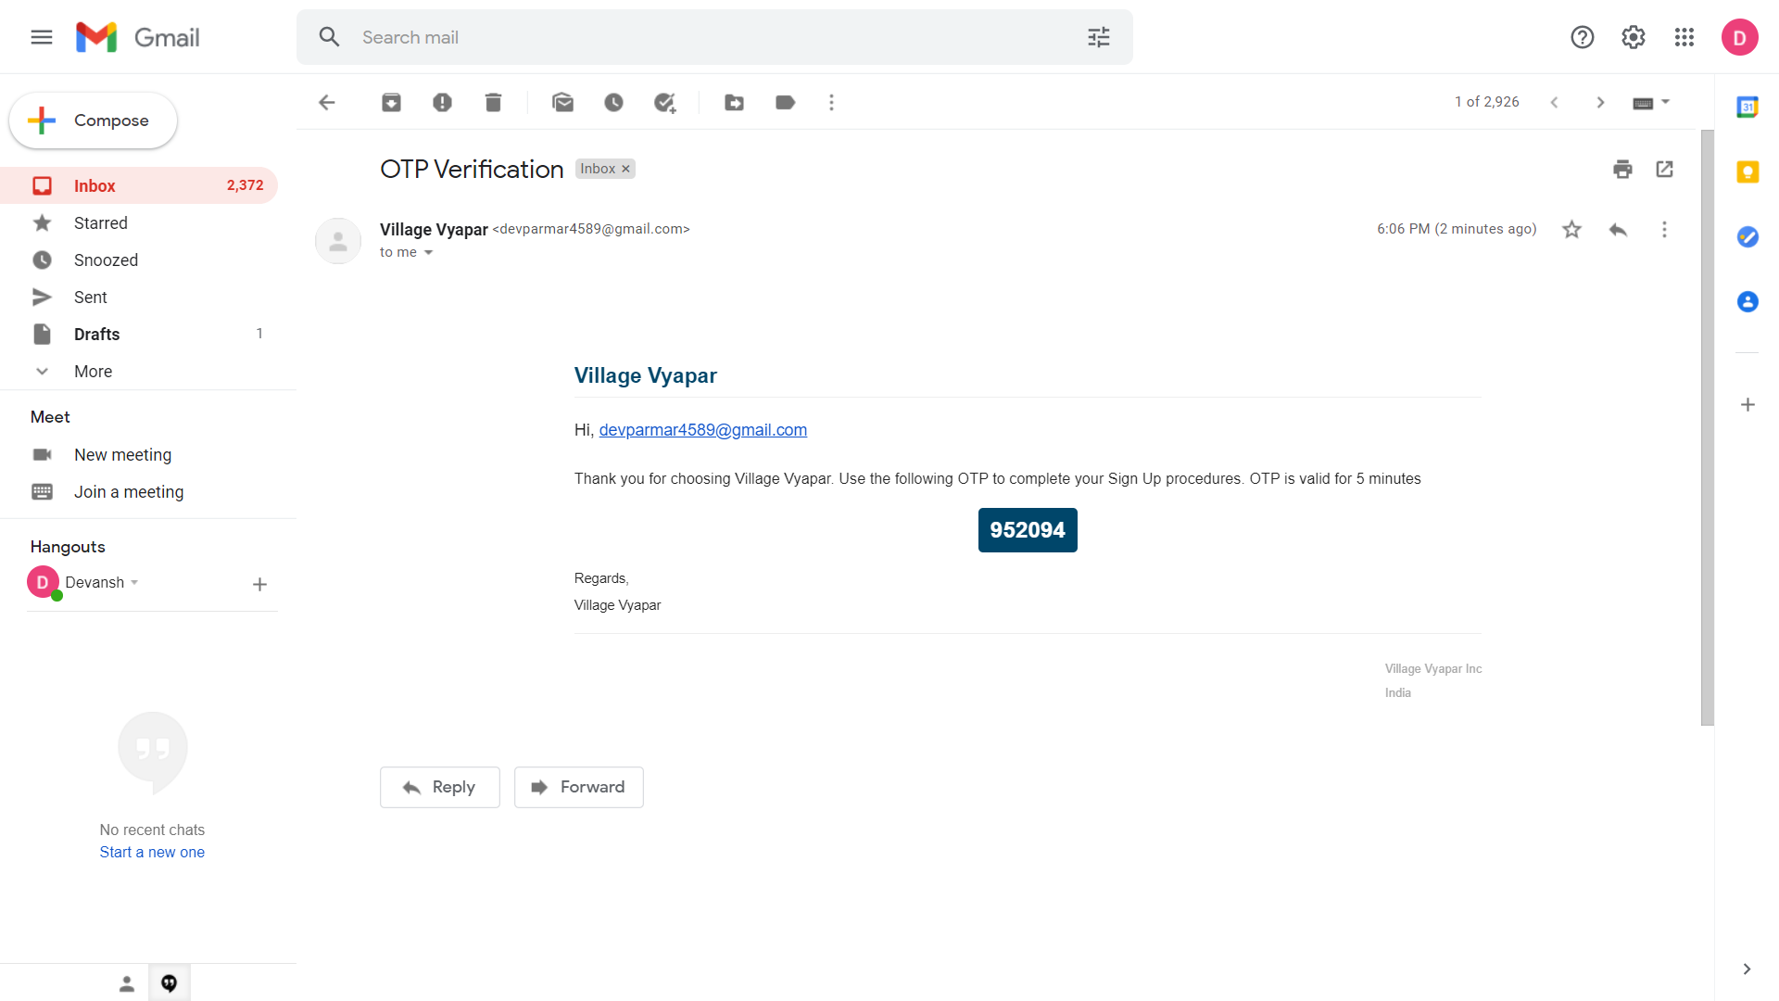
OTP sent at email on New Registration

Slide 25
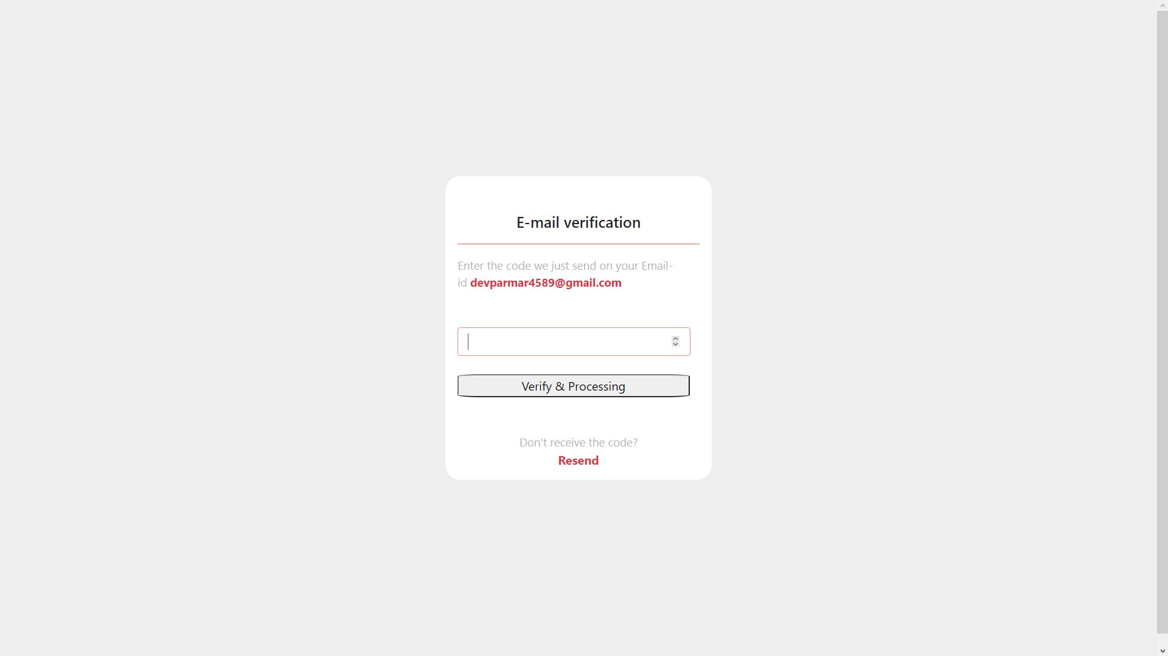
Confirm OTP sent at email

Slide 26

Homepage after Registration and login

Slide 27

Login with invalid credentials

Slide 28
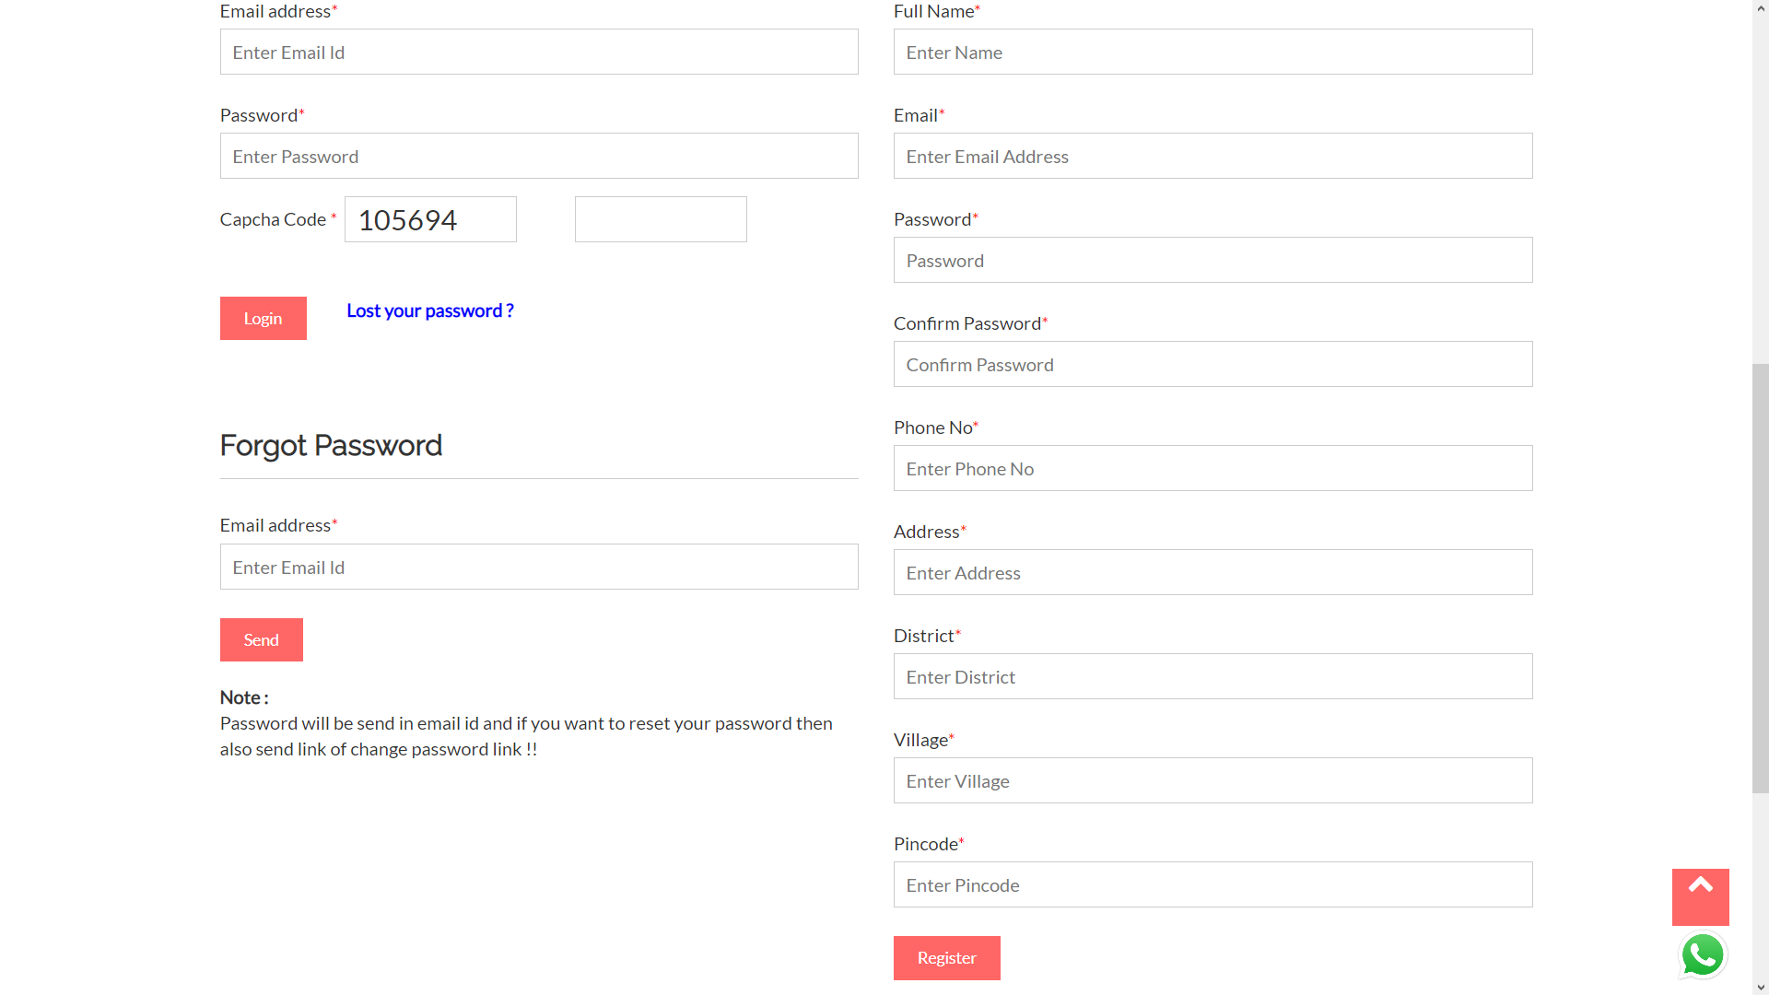
Forgot password

Slide 29

Lost password sent at email address

Slide 30
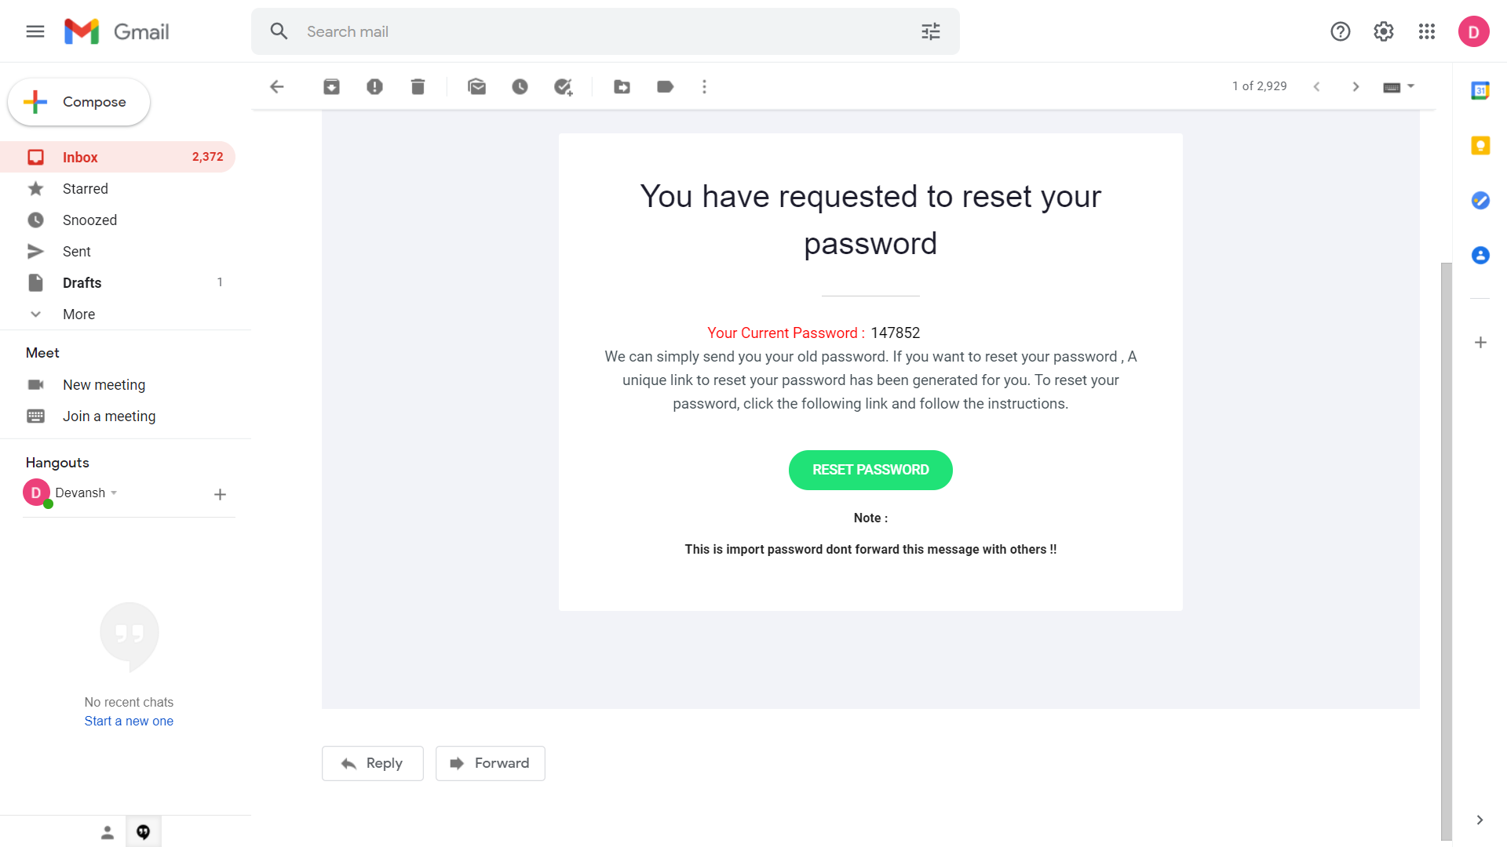
Email sent for lost password

Slide 31
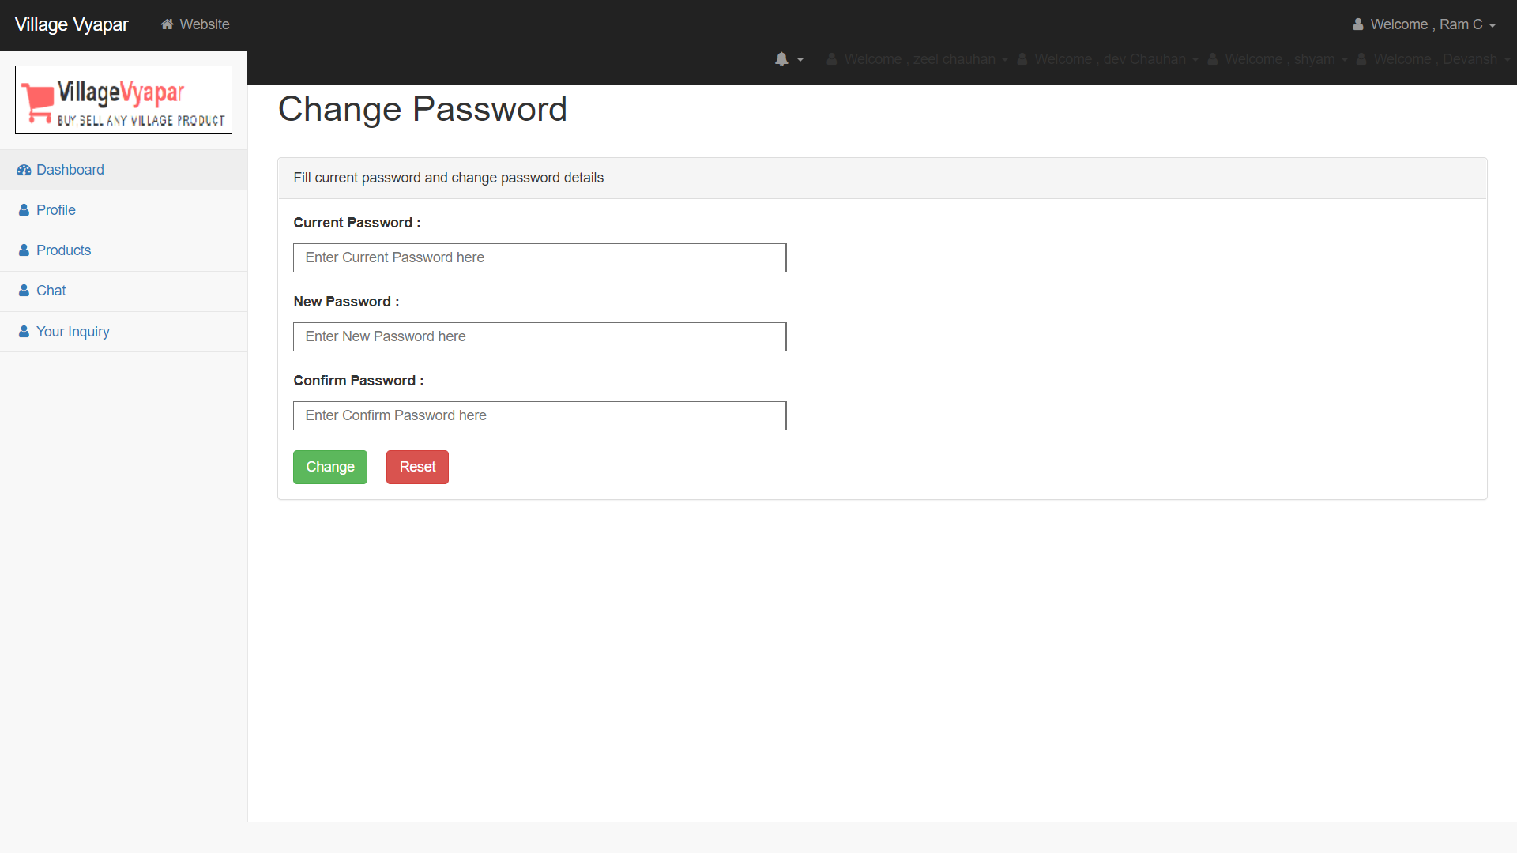
Reset password

Slide 32

Welcome page after login

Slide 33

Welcome page

Slide 34
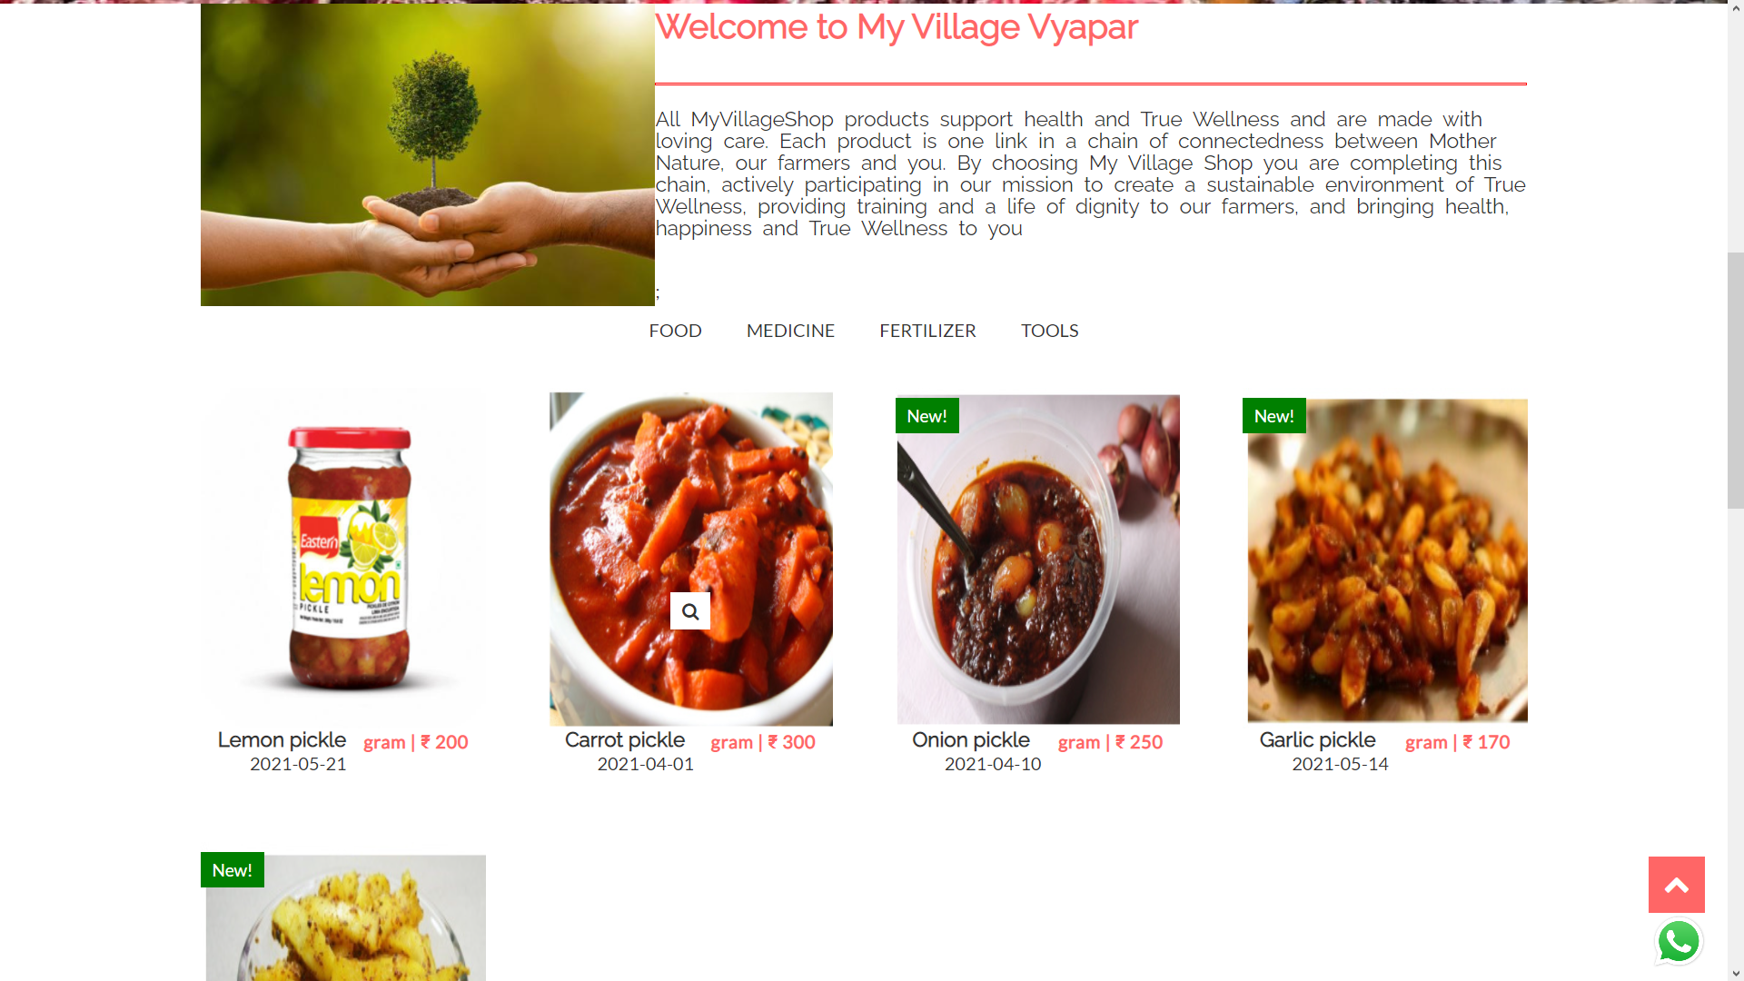
Welcome page

Slide 35
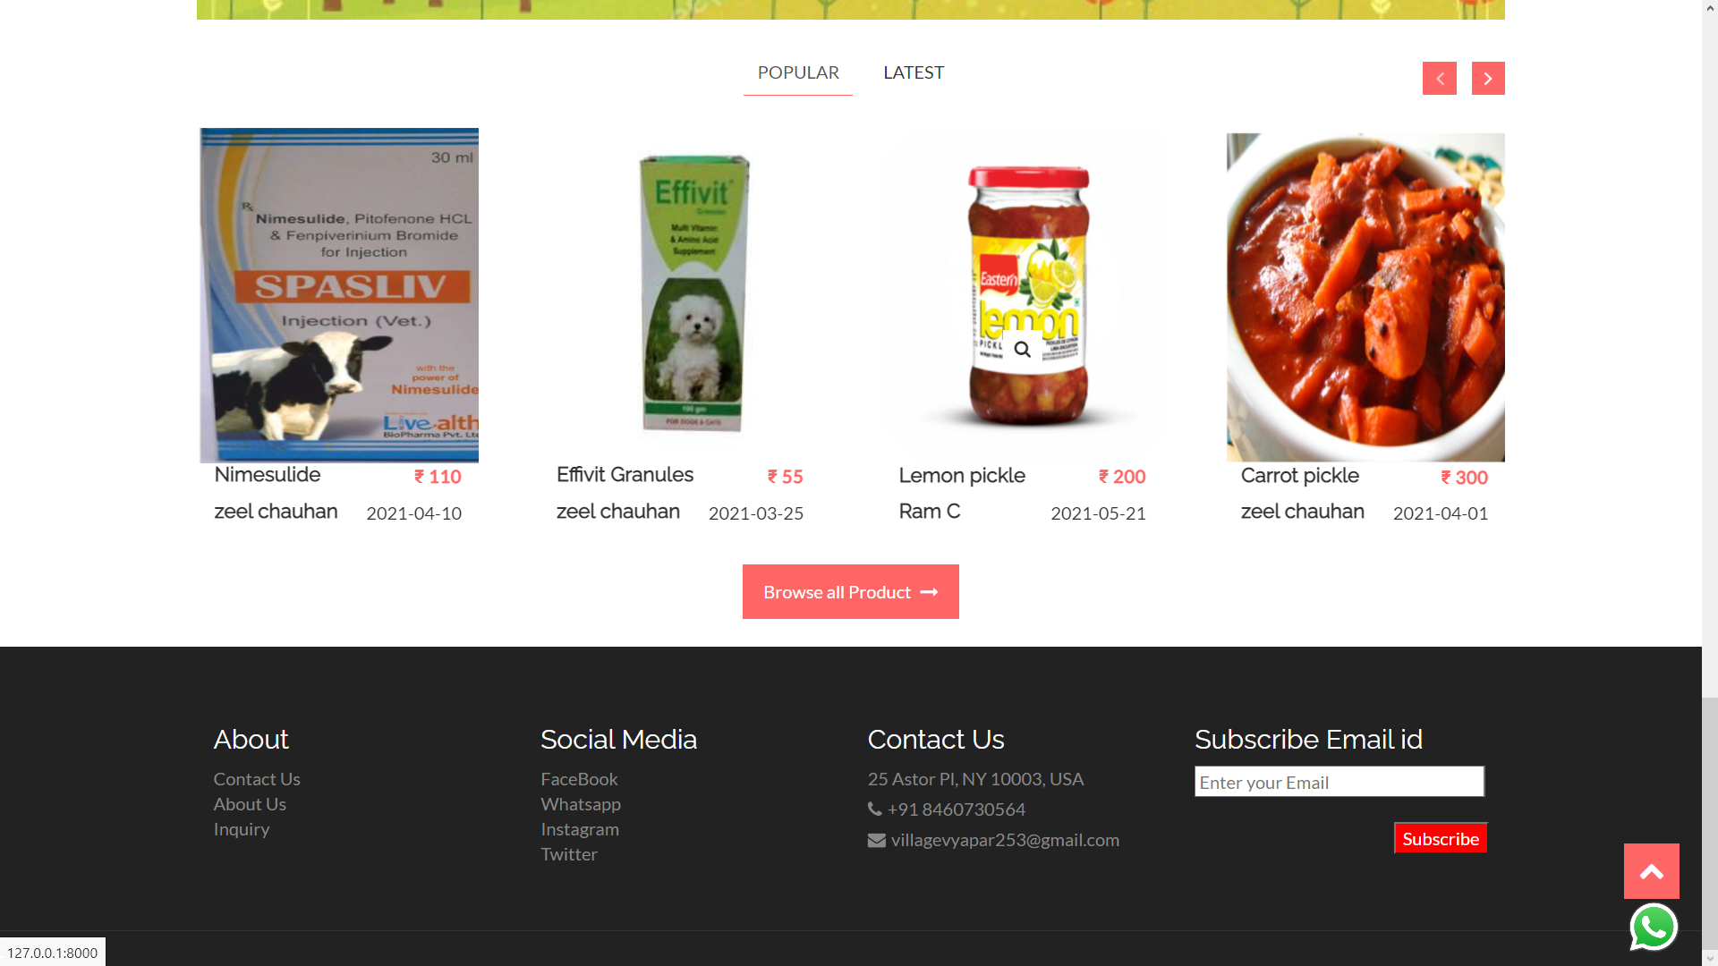
Welcome page Popular products

Slide 36
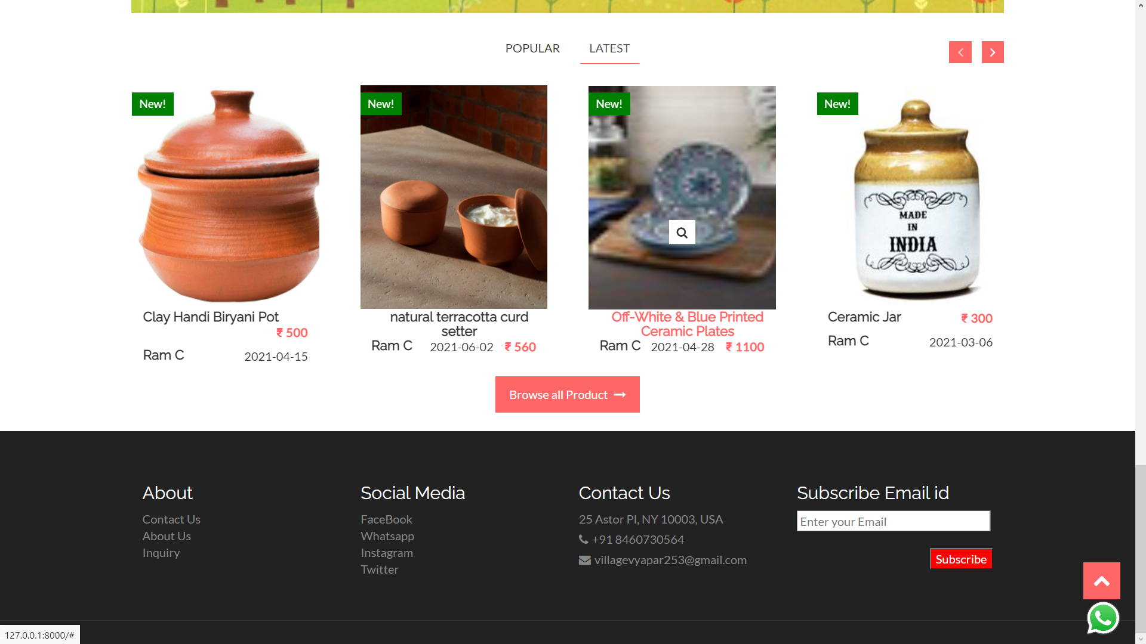
Welcome page Latest products

Slide 37
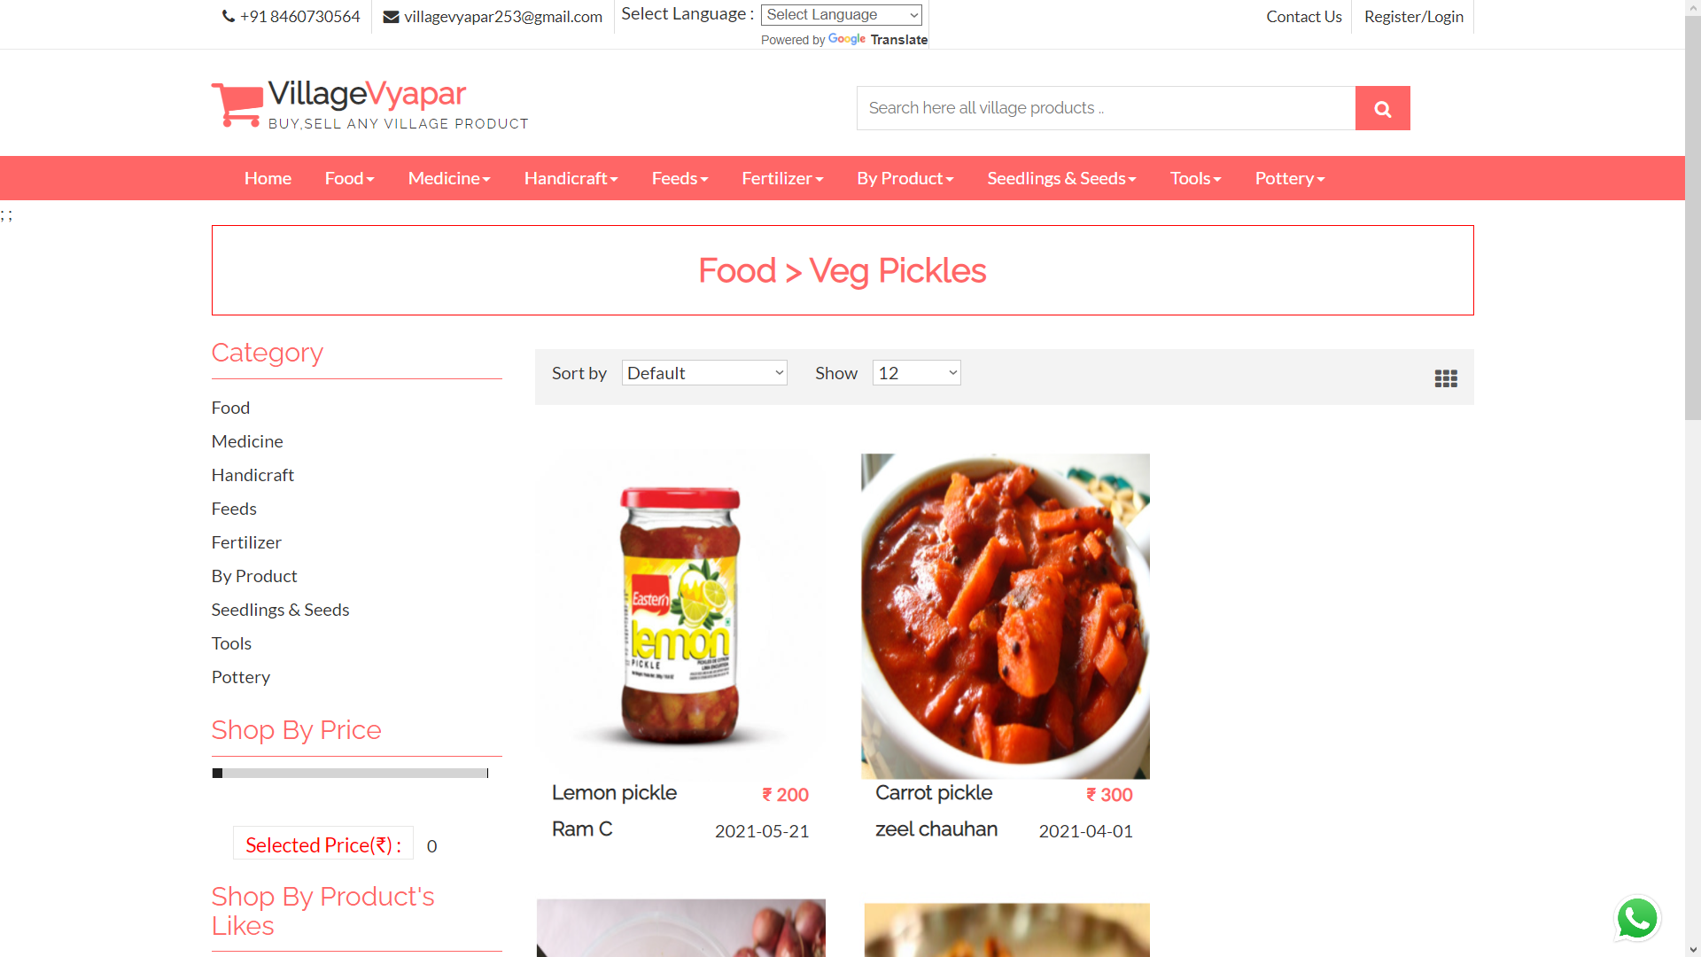
Products within subcategories

Slide 38
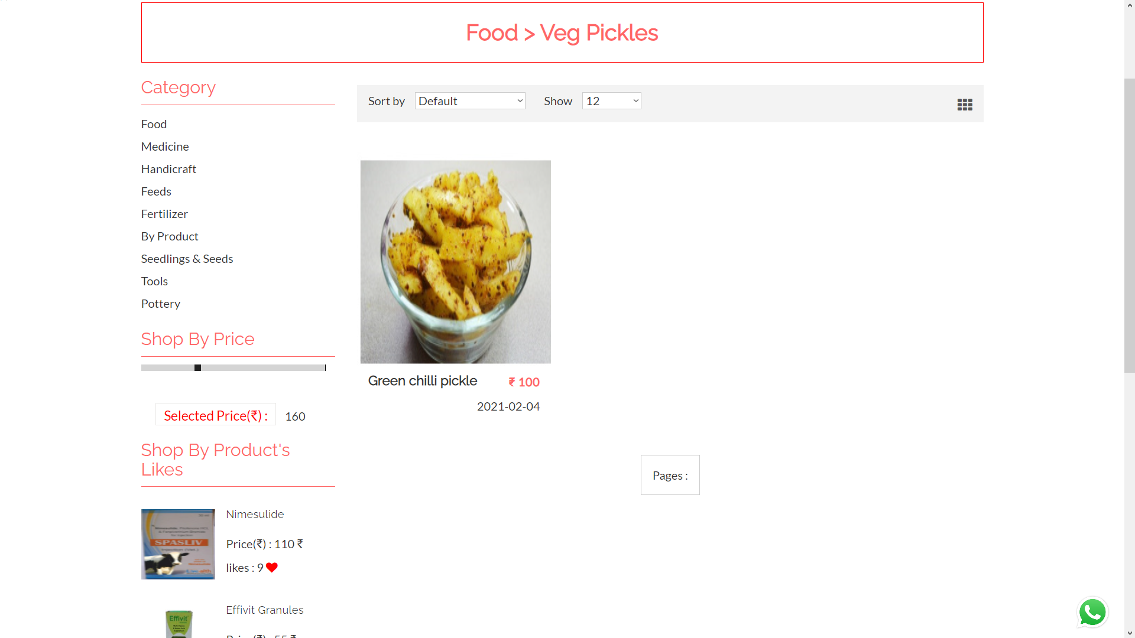
Products limited with price

Slide 39
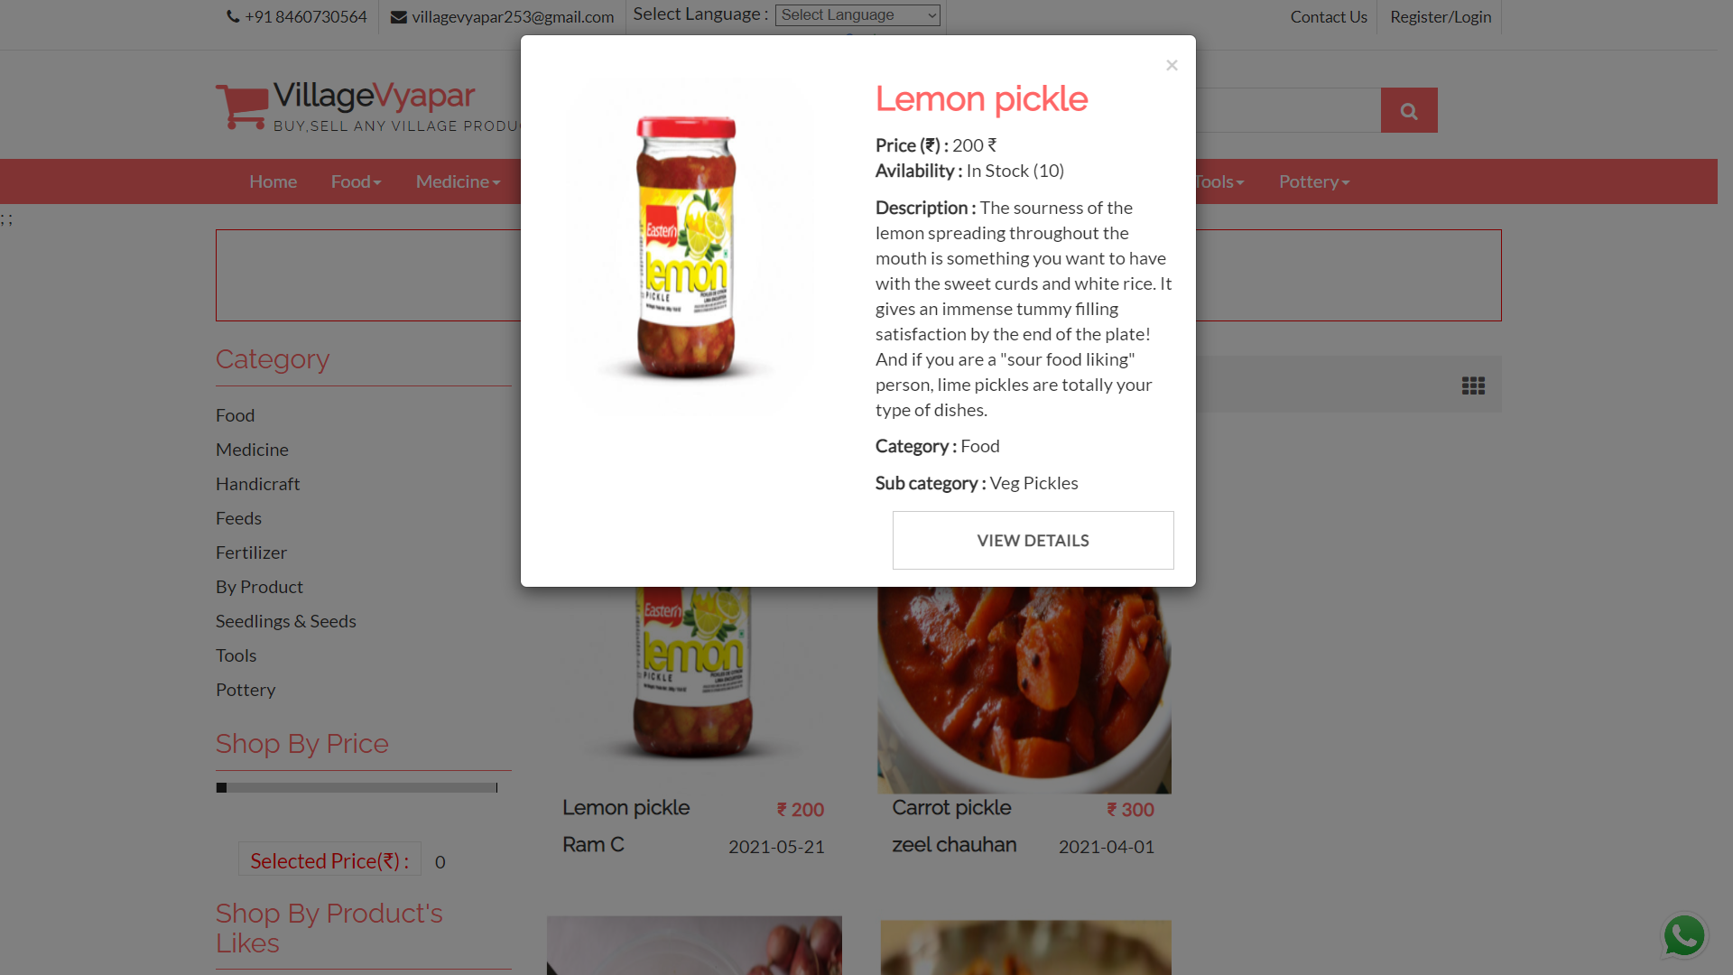
Product detail dialogue box

Slide 40
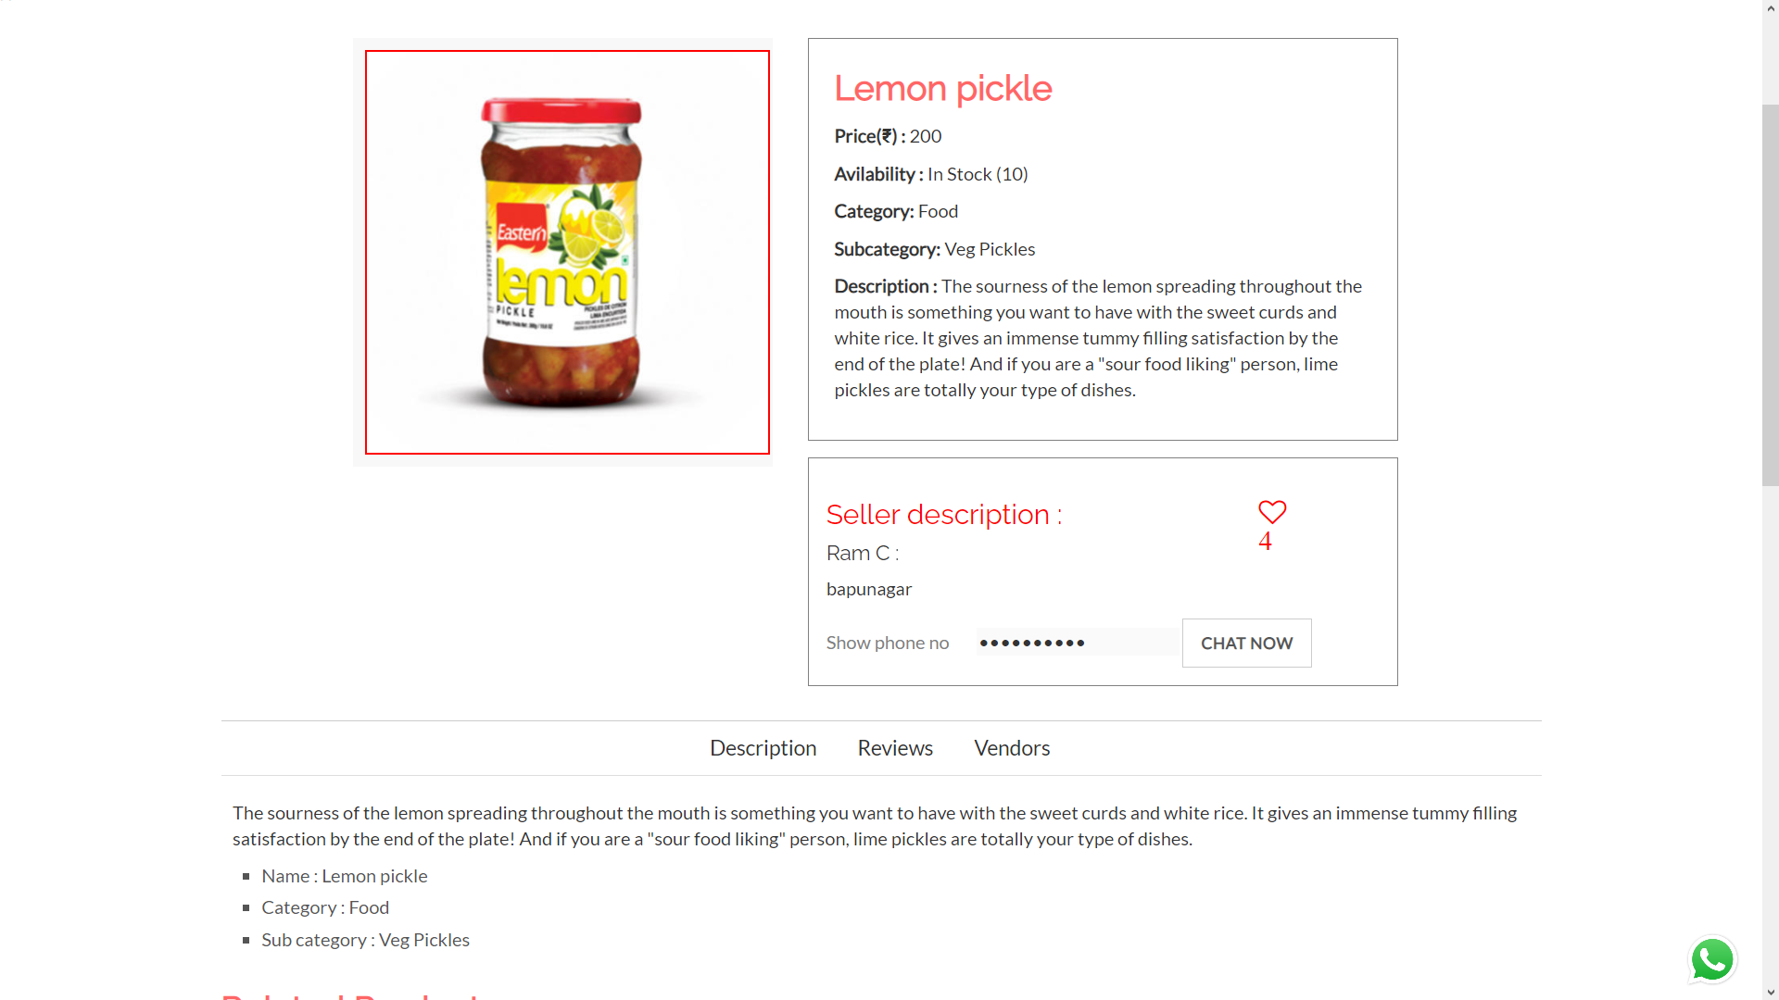
Product details

Slide 41
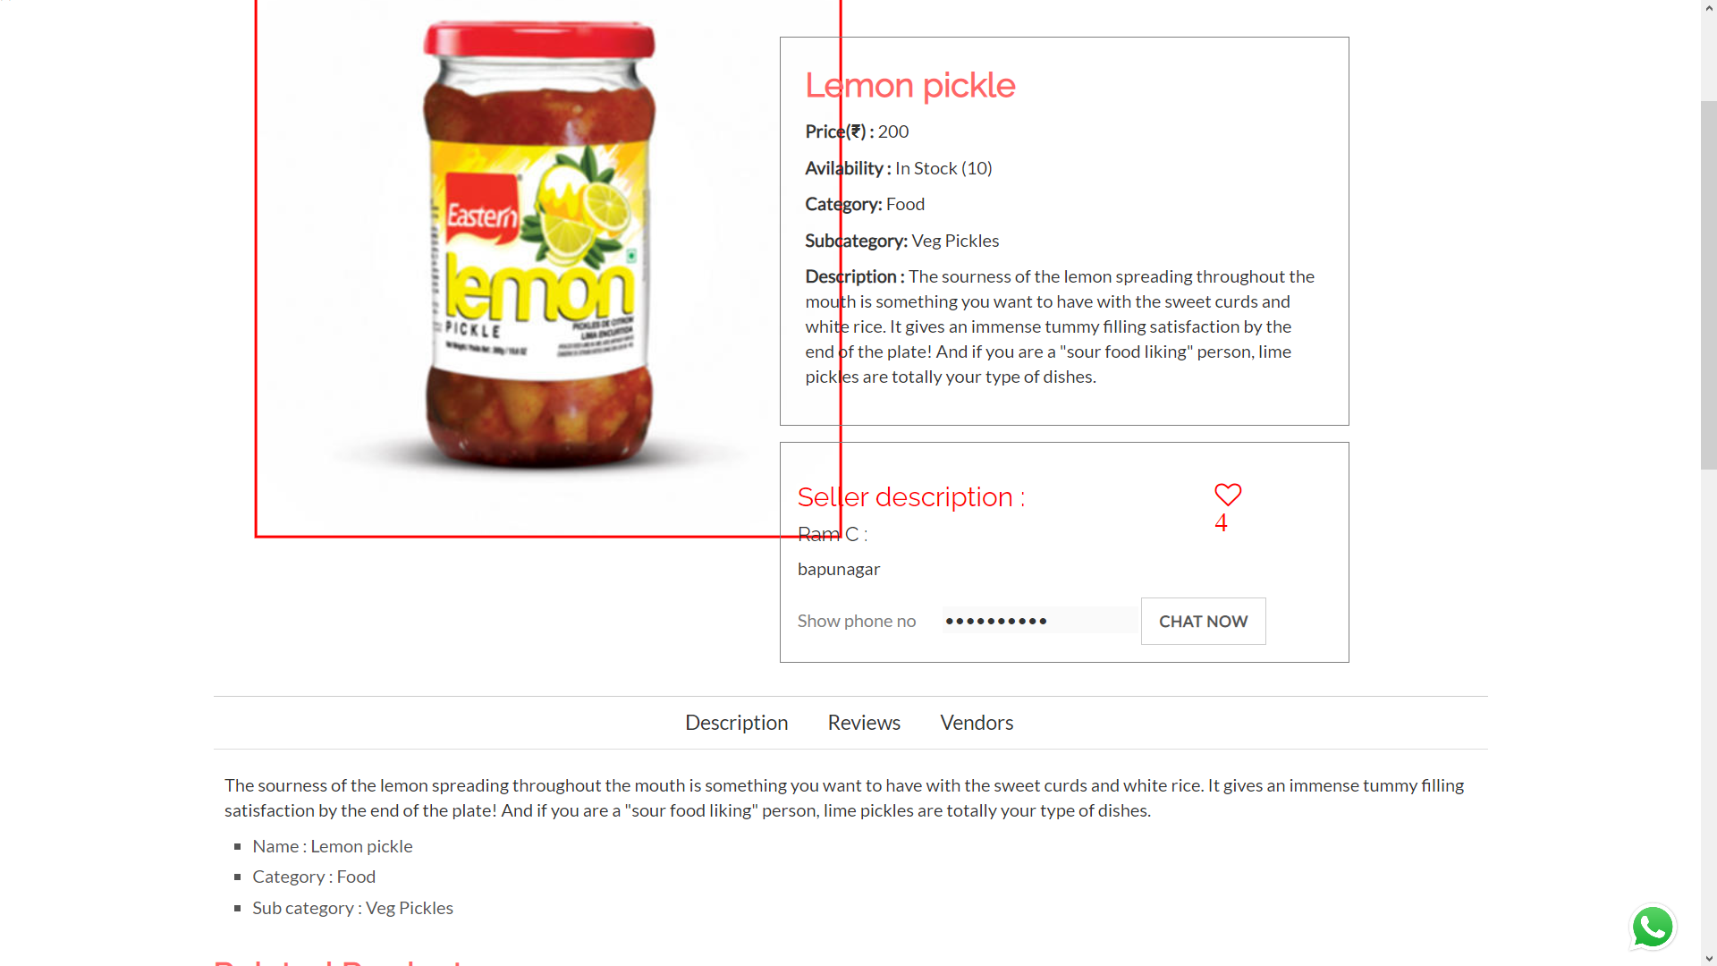
Product image zoomed

Slide 42
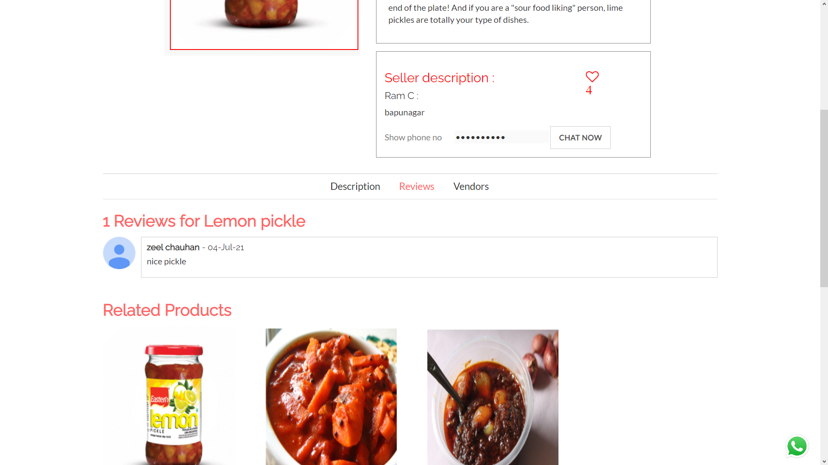
Product review

Slide 43
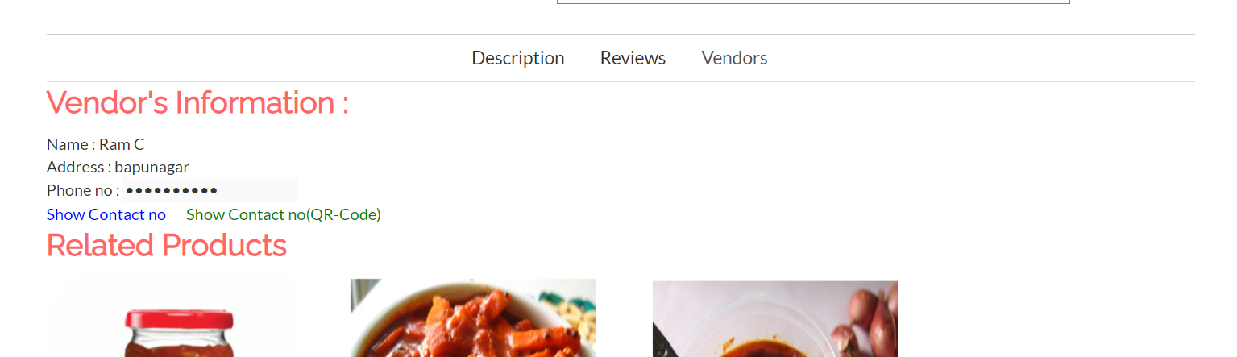
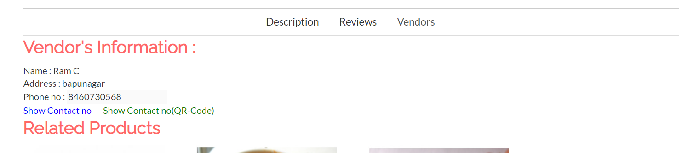
Vendor info 1

Slide 44
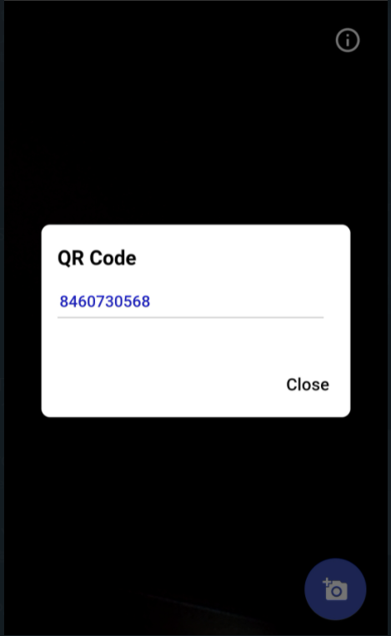
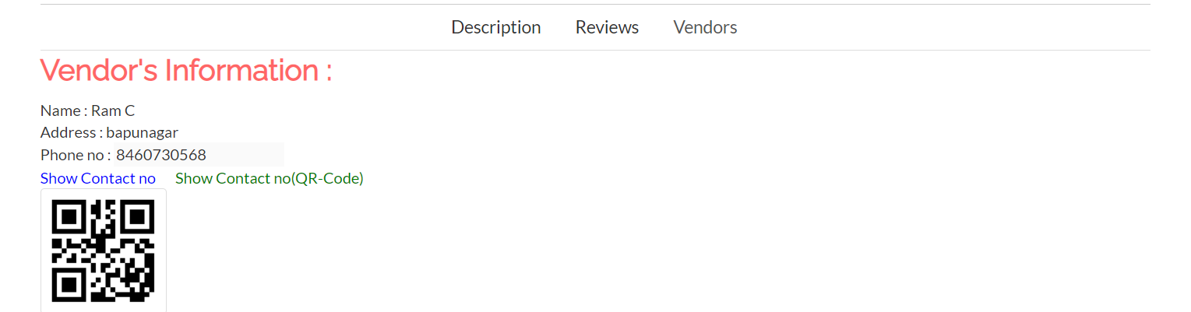
Vendor info 2

Slide 45
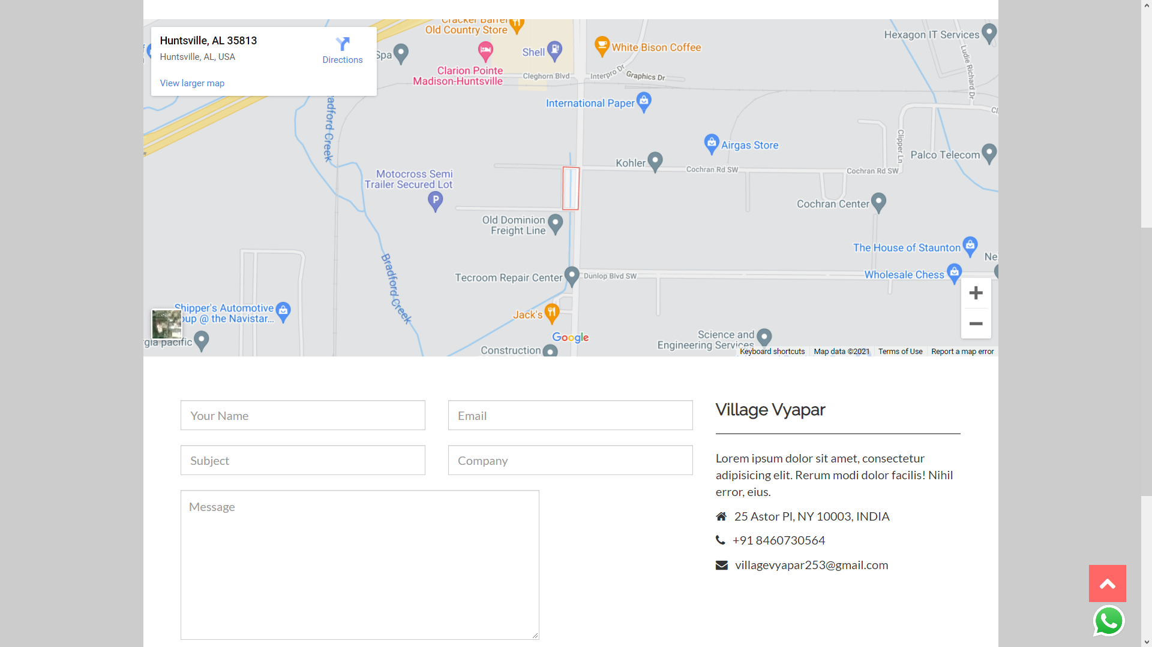
Contact us

Slide 46
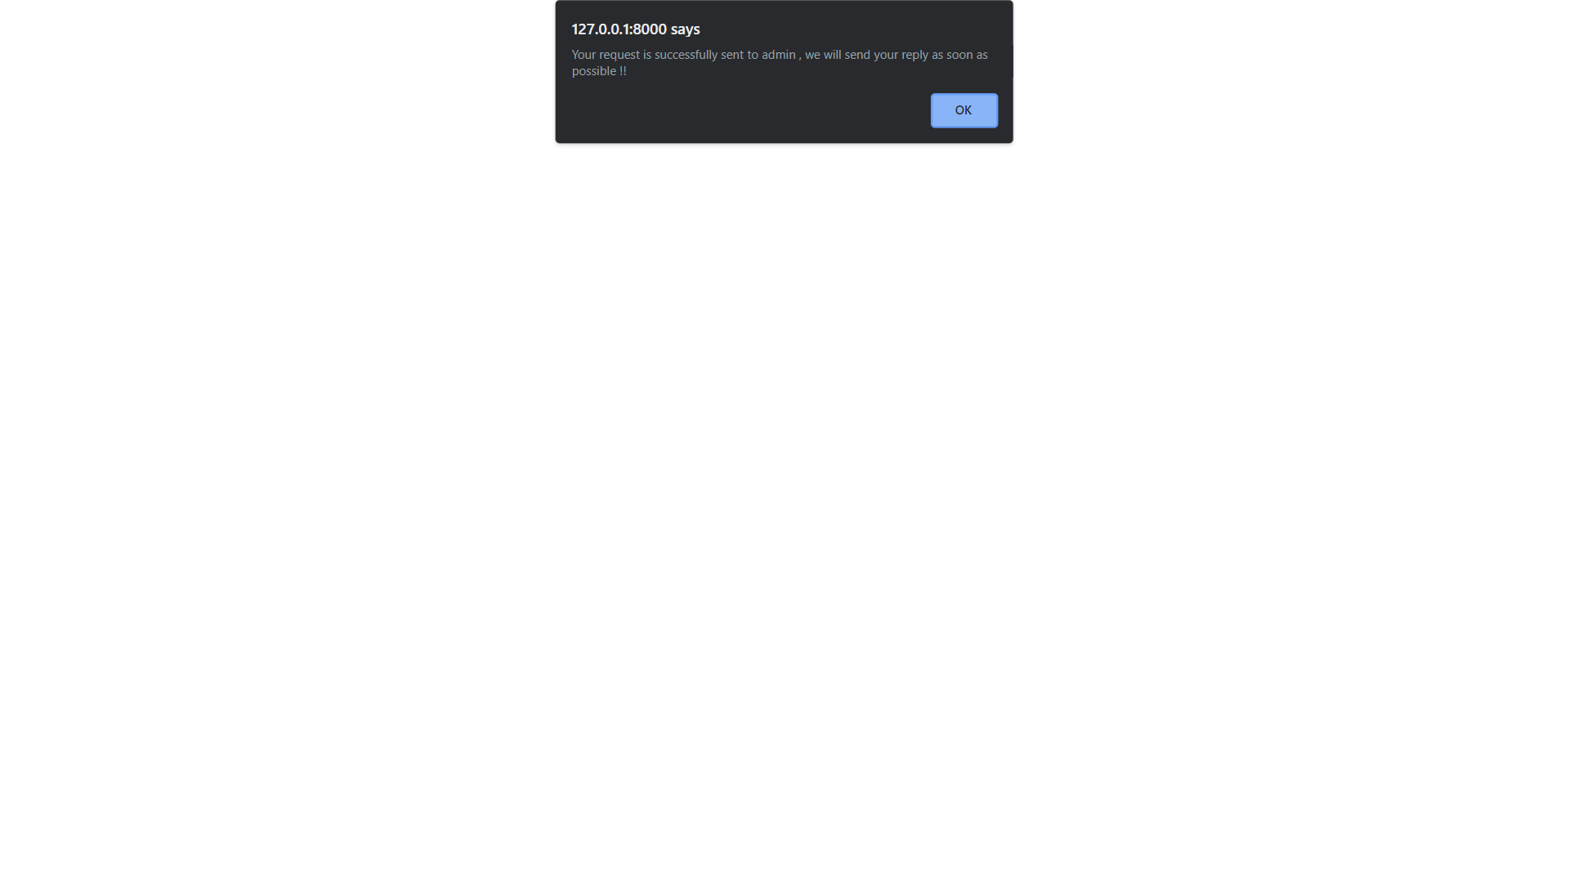
Inquiry asked

Slide 47
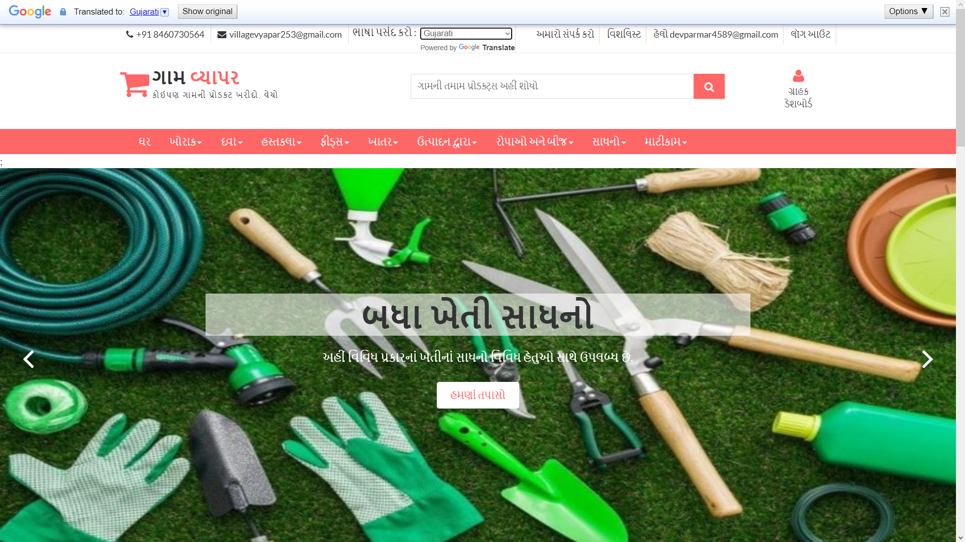
Language changes

Slide 48
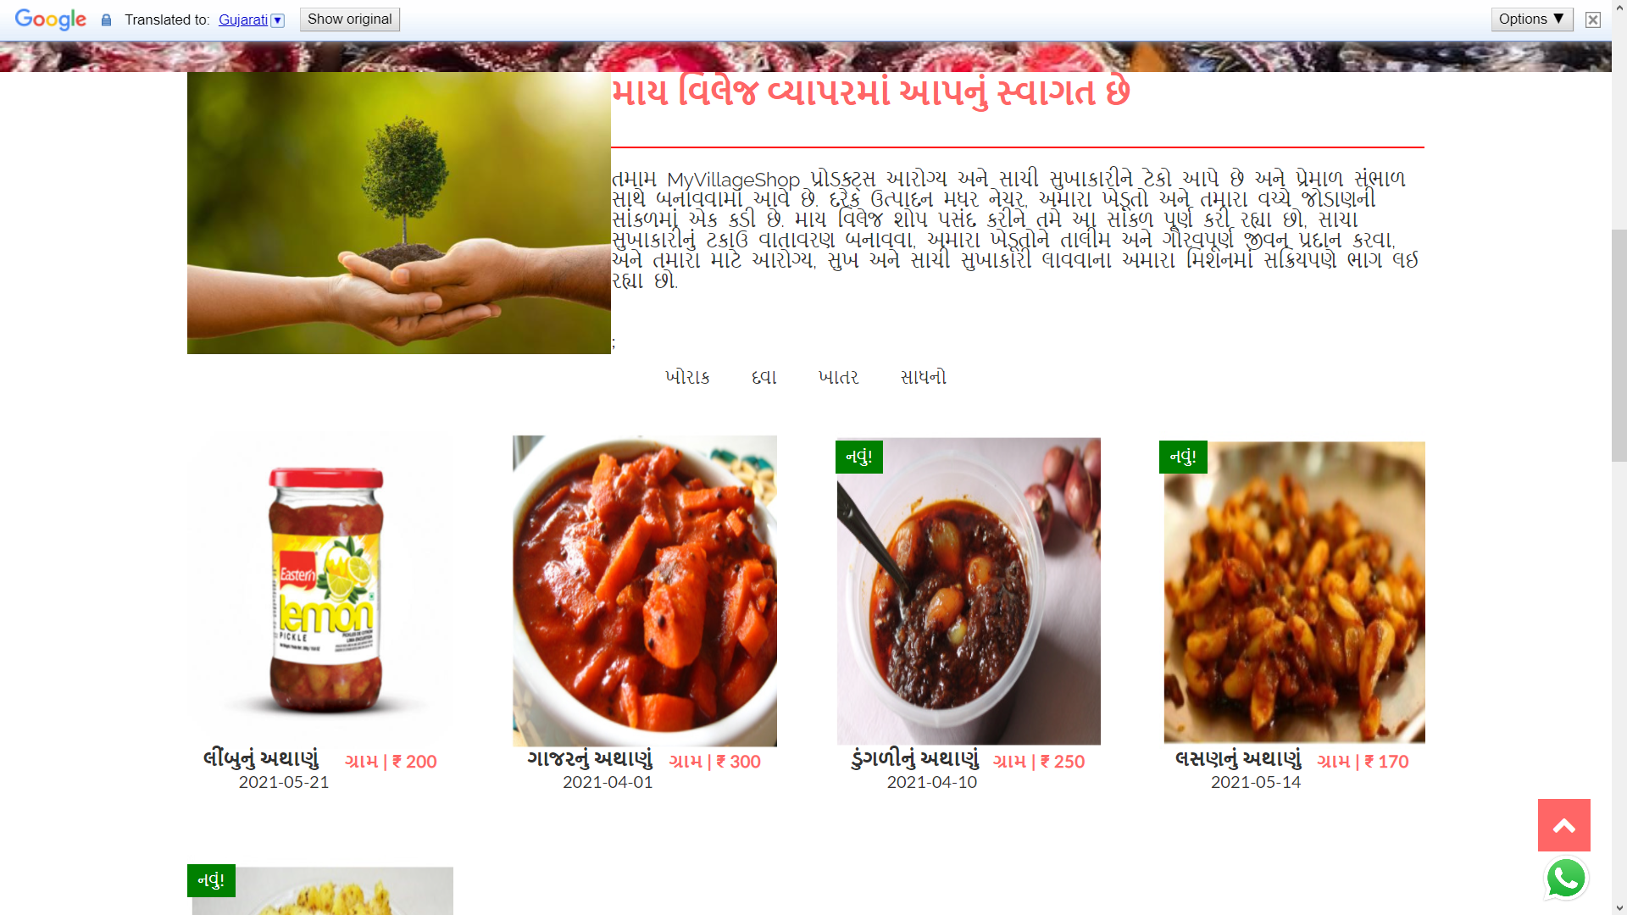
Language changes

Slide 49
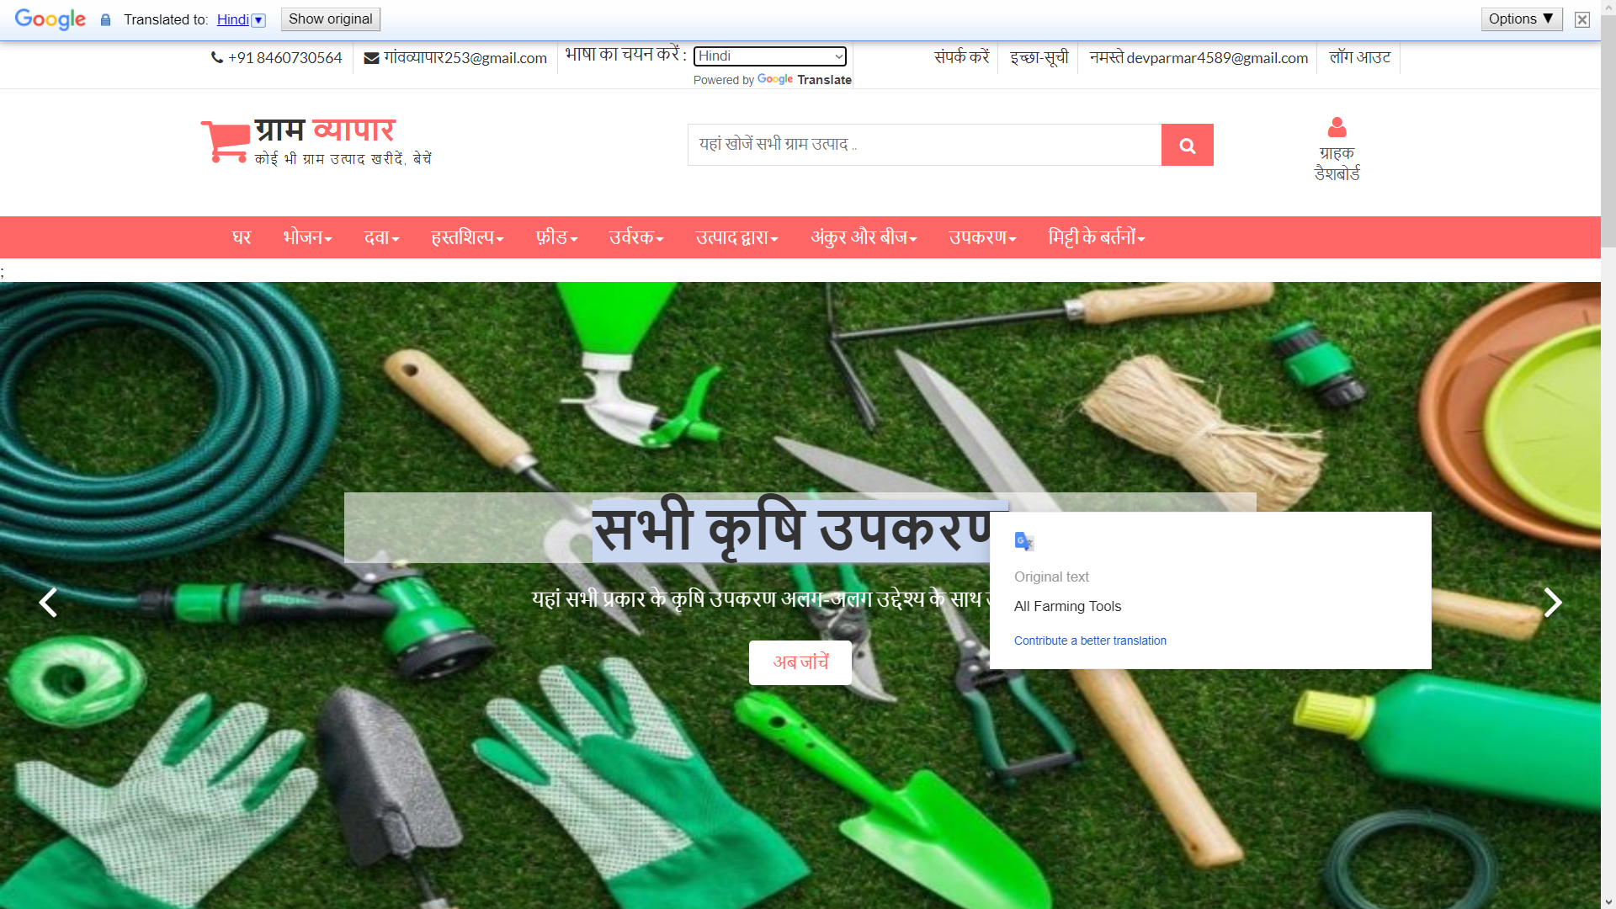
Language changes

Slide 50
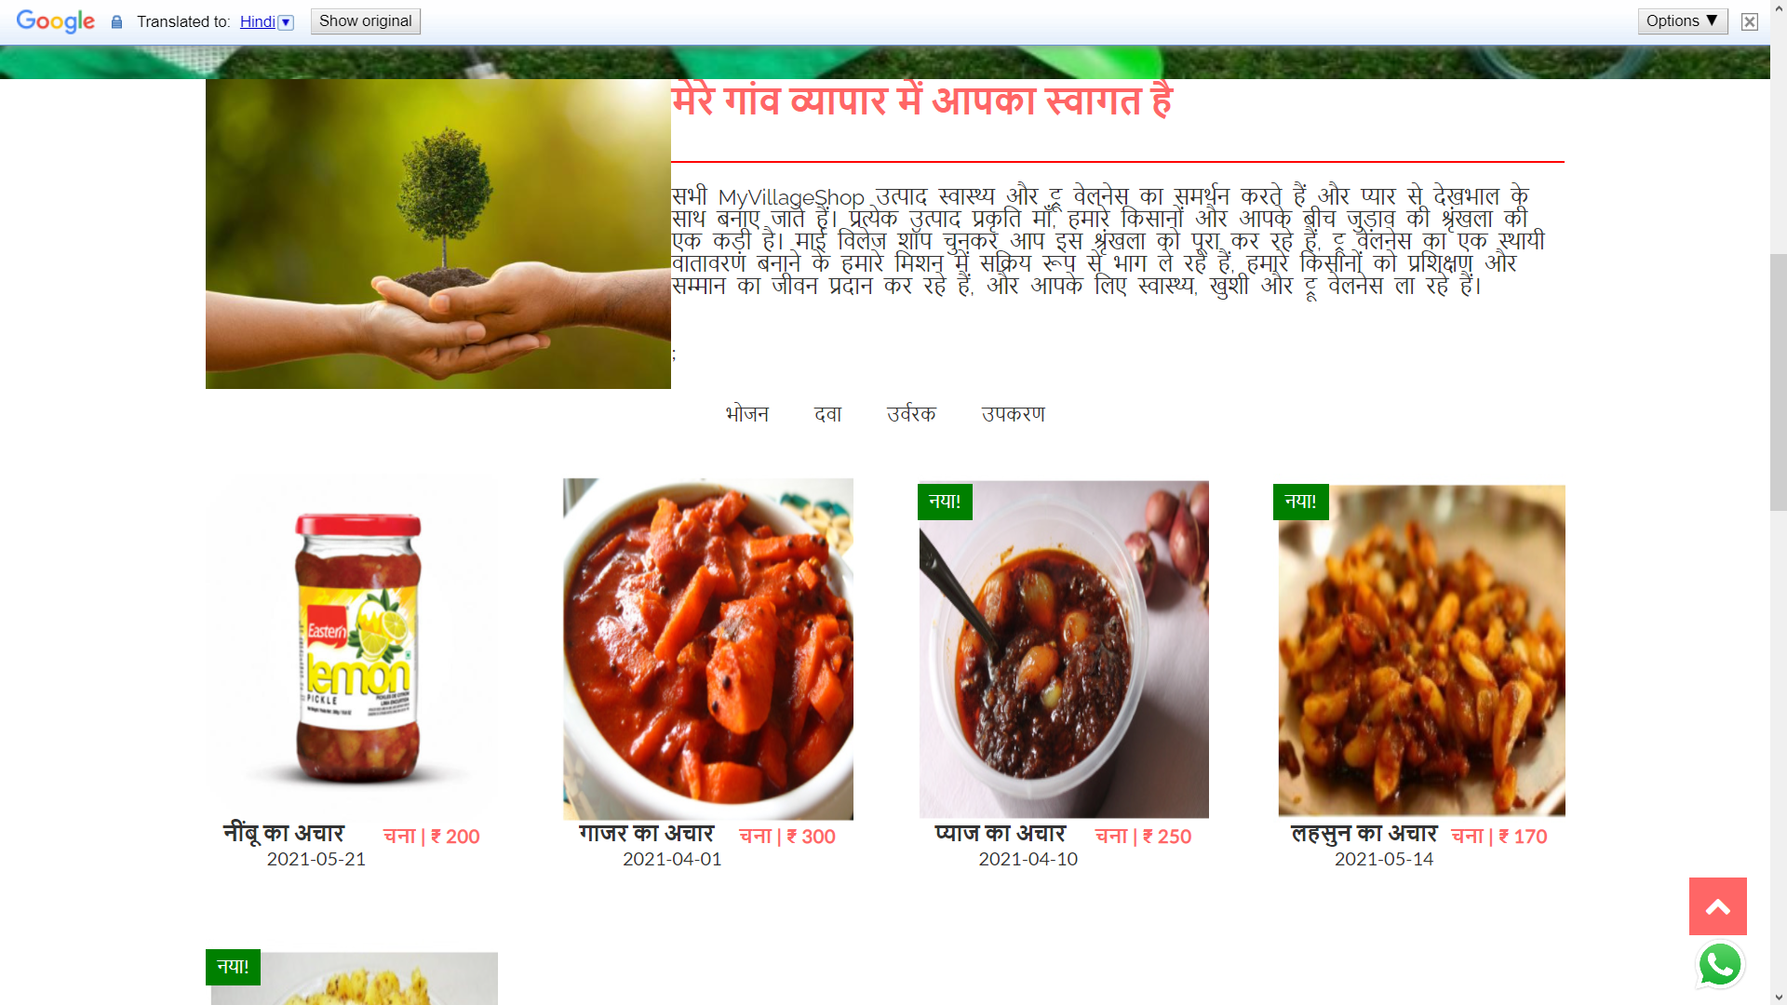
Language changes

Slide 51
Login

Slide 52
Targeted Users

Slide 53
3
Screen-shots (Admin)

Slide 54
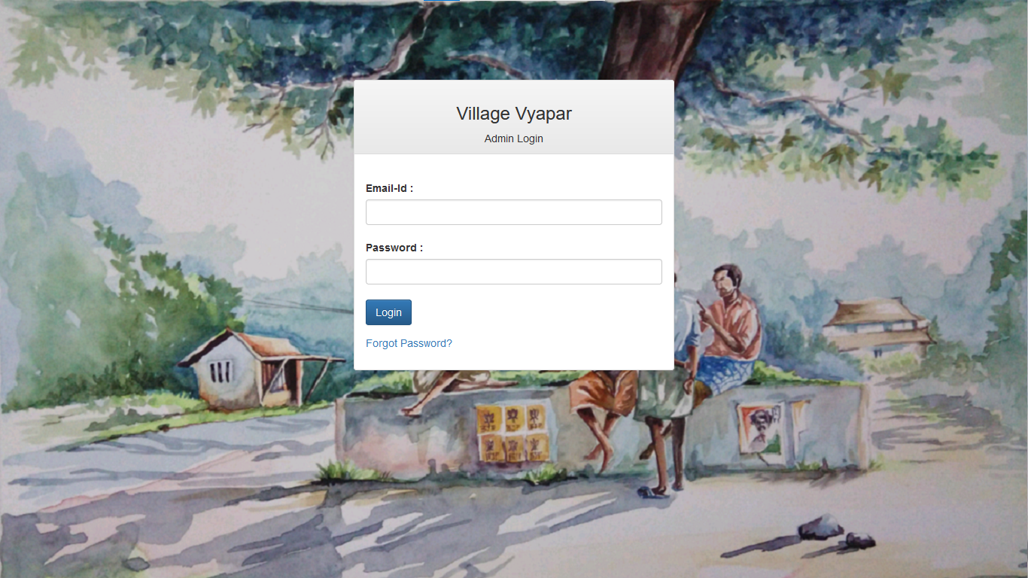
Admin-login Page

Slide 55
3
System Design

Slide 56
Use Case Diagram

Slide 57
Class Diagram

Slide 58
Interaction Diagram

Slide 59
Activity Diagram

Slide 60
Data Dictionary

Slide 61
4
Development

Slide 62
5
Proposed Enhancement

Slide 63
6
Conclusion

Slide 64
7
Bibliography

Slide 65
CONTENTS
1
4
ADD THE SLIDE TITLE HERE
ADD THE SLIDE TITLE HERE
Please add a comment here
Please add a comment here
2
5
ADD THE SLIDE TITLE HERE
ADD THE SLIDE TITLE HERE
Please add a comment here
Please add a comment here
3
6
ADD THE SLIDE TITLE HERE
ADD THE SLIDE TITLE HERE
Please add a comment here
Please add a comment here

Slide 66
1
ADD THE SLIDE TITLE HERE
PLEASE ADD SLIDE SUBTITLE HERE

Slide 67



Please add title in here
ADD
KEY
WORDS
Please add text here, according to the need to adjust the font and font size. Please add text here, according to the need to adjust the font and font size.
Please add text here, according to the need to adjust the font and font size. Please add text here, according to the need to adjust the font and font size.
Please add text here, according to the need to adjust the font and font size.
ADD
KEY
WORDS
ADD
KEY
WORDS
Please add title in here
Please add text here, according to the need to adjust the font and font size.

Slide 68
Please add title in here
Please add text here, according to the need to adjust the font and font size. Please add text here.
Please add text here, according to the need to adjust the font and font size. Please add text here, according to the need to adjust the font and font size.
1 ADD KEY WORDS
Please add text here, according to the need to adjust the font and font size. Please add text here.
2 ADD KEY WORDS
Please add text here, according to the need to adjust the font and font size. Please add text here.
3 ADD KEY WORDS
Please add text here, according to the need to adjust the font and font size. Please add text here.
4 ADD KEY WORDS
Please add text here, according to the need to adjust the font and font size. Please add text here.
5 ADD KEY WORDS

Slide 69

Please add title in here
Please add text here, according to the need to adjust the font and font size. Please add text here, according to the need to adjust the font and font size.
Please add text here, according to the need to adjust the font and font size. Please add text here, according to the need to adjust the font and font size.
Please add title in here
Please add text here, according to the need to adjust the font and font size. Please add text here.

Slide 70
Please add text here, according to the need to adjust the font and font size, recommended justified form.
64%
50%
75%
ADD KEY WORDS
ADD KEY WORDS
ADD KEY WORDS
Please add text here, according to the need to adjust the font and font size.
Please add text here, according to the need to adjust the font and font size.
Please add text here, according to the need to adjust the font and font size.

Slide 71
ADD KEY WORDS
ADD KEY WORDS
Please add text here, according to the need to adjust the font and font size. Please add text here, according to the need to adjust the font and font size.
Please add text here, according to the need to adjust the font and font size. Please add text here, according to the need to adjust the font and font size.
Please add text here, according to the need to adjust the font and font size. Please add text here, according to the need to adjust the font and font size.
ADD KEY WORDS
Please add text here, according to the need to adjust the font and font size, recommended justified form. Please add text here, according to the need to adjust the font and font size.

Slide 72
10
Please add text here, according to the need to adjust the font and font size.
09
08
07
06
05
04
03
02
01
01
02
03
04
05
06
07
08
09
10
11
12
Please add text here, according to the need to adjust the font and font size, recommended justified form.

Slide 73
ADD KEY WORDS
ADD KEY WORDS
ADD KEY WORDS
Please add text here, according to the need to adjust the font and font size. Please add text here, according to the need to adjust the font and font size.
Please add text here, according to the need to adjust the font and font size. Please add text here, according to the need to adjust the font and font size.
Please add text here, according to the need to adjust the font and font size. Please add text here, according to the need to adjust the font and font size.
Please add text here, according to the need to adjust the font and font size. Please add text here, according to the need to adjust the font and font size.

Slide 74


Please add text here, according to the need to adjust the font and font size. Please add text here, according to the need to adjust the font and font size.
Please add text here, according to the need to adjust the font and font size. Please add text here, according to the need to adjust the font and font size.
Please add text here, according to the need to adjust the font and font size. Please add text here, according to the need to adjust the font and font size. Please add text here, according to the need to adjust the font and font size. Please add text here, according to the need to adjust the font and font size.

Slide 75
Please add title in here
Please add text here, according to the need to adjust the font and font size.
000T
000T
000T
000T
000T
000T
000T
000T
000T
000T
000T
000T
01
02
03
04
05
06
07
08
09
10
11
12
Please add text here, according to the need to adjust the font and font size. Please add text here, according to the need to adjust the font and font size.

Slide 76
Please add text here, according to the need to adjust the font and font size.
Please add text here, according to the need to adjust the font and font size.
ADD KEY WORDS
ADD KEY WORDS
ADD KEY WORDS
ADD KEY WORDS
Please add text here, according to the need to adjust the font and font size.
Please add text here, according to the need to adjust the font and font size.
Please add text here, according to the need to adjust the font and font size. Please add text here, according to the need to adjust the font and font size. Please add text here, according to the need to adjust the font and font size. Please add text here.

Slide 77
3
ADD THE SLIDE TITLE HERE
PLEASE ADD SLIDE SUBTITLE HERE

Slide 78
Please add text here, according to the need to adjust the font and font size.
ADD KEY WORDS
Please add text here, according to the need to adjust the font and font size. Please add text here, according to the need to adjust the font and font size.
Please add text here, according to the need to adjust the font and font size. Please add text here, according to the need to adjust the font and font size.
ADD
KEY WORDS
ADD KEY WORDS
ADD KEY WORDS
ADD KEY WORDS
Please add text here, according to the need to adjust the font and font size.
Please add text here, according to the need to adjust the font and font size. Please add text here, according to the need to adjust the font and font size. Please add text here, according to the need to adjust the font and font size.

Slide 79



Please add text here, according to the need to adjust the font and font size. Please add text here, according to the need to adjust the font and font size.
5 ADD KEY WORDS
5 ADD KEY WORDS
5 ADD KEY WORDS
Please add text here, according to the need to adjust the font and font size. Please add text here, according to the need to adjust the font and font size.
Please add text here, according to the need to adjust the font and font size. Please add text here, according to the need to adjust the font and font size.
Please add text here, according to the need to adjust the font and font size. Please add text here, according to the need to adjust the font and font size.

Slide 80
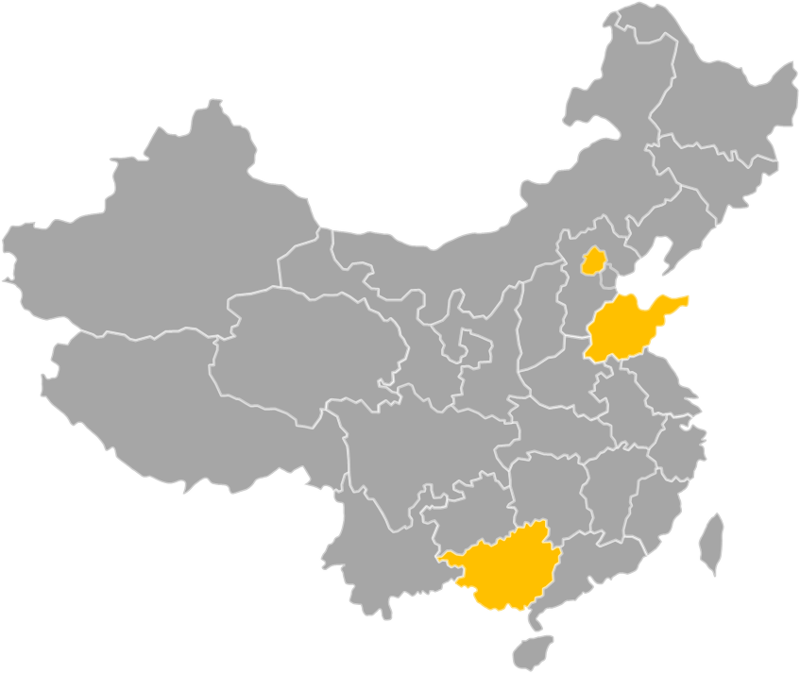
Please add title in here
Please add title in here
Please add text here, according to the need to adjust the font and font size.
Please add title in here
Please add text here, according to the need to adjust the font and font size.
Please add title in here
Please add text here, according to the need to adjust the font and font size.

Slide 81
Please add text here, according to the need to adjust the font and font size. Please add text here, according to the need to adjust the font and font size.
Please add text here, according to the need to adjust the font and font size. Please add text here, according to the need to adjust the font and font size.
Please add text here, according to the need to adjust the font and font size. Please add text here, according to the need to adjust the font and font size.
ADD KEY WORDS
ADD KEY WORDS
ADD KEY WORDS
Please add text here, according to the need to adjust the font and font size. Please add text here, according to the need to adjust the font and font size.

Slide 82
Please add title in here
Please add title in here
Please add text here, according to the need to adjust the font and font size. Please add text here, according to the need to adjust the font and font size.
Please add text here, according to the need to adjust the font and font size. Please add text here, according to the need to adjust the font and font size.
Please add text here, according to the need to adjust the font and font size. Please add text here, according to the need to adjust the font and font size.
Please add text here, according to the need to adjust the font and font size. Please add text here, according to the need to adjust the font and font size.
Please add text here, according to the need to adjust the font and font size. Please add text here, according to the need to adjust the font and font size. Please add text here, according to the need to adjust the font and font size.

Slide 83
THANK YOU
Group No : 04

